Slide 1


Open and Responsible (Data) Science Citizenship 2
Louise Bezuidenhout
August 2024 CODATA-RDA Data Science School

Slide 2
Plan
Personal concerns and implementing OS practices at home
What have we learned this week?
What challenges do we have about implementing these in our research environments?
What kinds of assistance can we get?
RCR and the “bigger picture”
Designing just systems
Avoiding biases and marginalizations

Slide 3
Recap From Monday

Slide 4
Open Science
The products of scientific research should be freely available to everyone to use and republish as they wish, without restrictions from copyright, patents or other mechanisms of control
Transparency in experimental methodology, observation, and collection of data
Public availability and reusability of scientific data
Public accessibility and transparency of scientific communication
Using web-based tools to facilitate scientific collaboration

Slide 5
Openness and Responsible Conduct of Research
Open Lab Books: Transparency in research practices
Sharing and openness: enhance transmission of values
Open Data and Open Methodologies:
Improve transparency and reproducibility of research
Open Peer Review: Transparency in peer review leads to better dialogue and collegial behaviour
Open Access: Improves availability of research outputs
Open publishing: leads to improved citations, credit and collaboration
Open Science Tools:
Improve collaboration

Slide 6
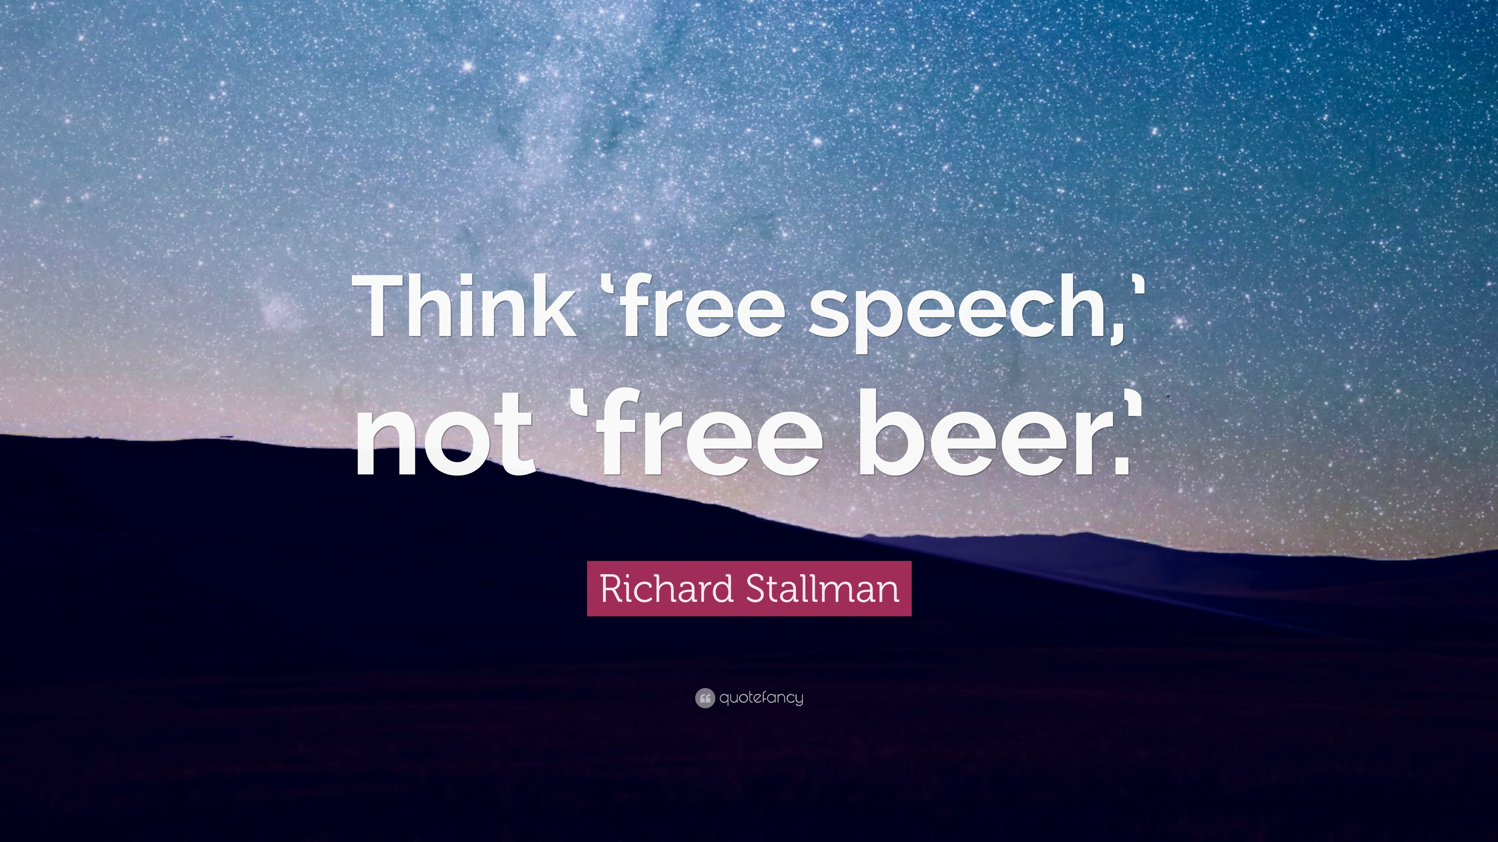

Slide 7
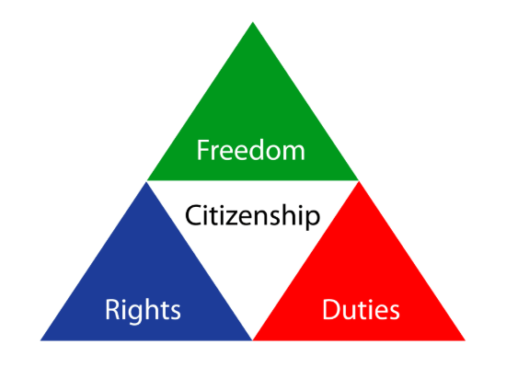
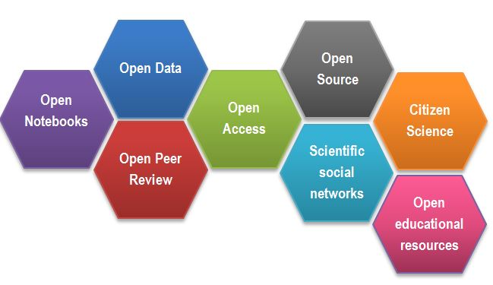
Open and Responsible Science Citizenship
Consider ethics in daily activities
Engage in discussions about the “big picture”
Contribute, safeguard and curate community resources
Contribute to community-building activities
Uphold and promote community values
https://www.fosteropenscience.eu/content/what-open-science-introduction

Slide 8
Open Science Throughout The Research Lifecycle
Open Access
Author Carpentry
GitHub
RDM
Shell
R
Acquire
Open Data
Present
Clean
Validate
Open Materials
RDM
GitHub
Explore
Model
Preprocess
Open Source
Shell
R
Heidi Seibold
tinyurl.com/opendatascience

Slide 9
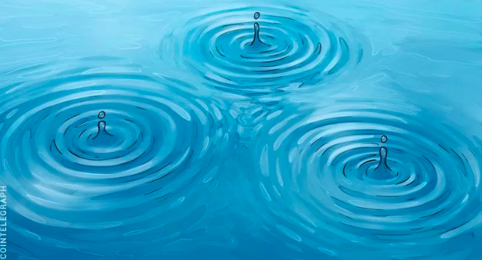
Everything Has Ethical Considerations
Research practices and the tools that underpin them have ethical implications
Being aware of their characteristics/specifications can help you avoid building in ethical complications into your work
Legal requirements – ie. GitHub, repository requirements
Marginalization of learners/users – using CLI instead of GUI
Re-use of data – sharing data, not respecting restrictions
Responsible publishing vs predatory journals
Using resources without contributing
Even the smallest tools can have significant ethical consequences

Slide 10

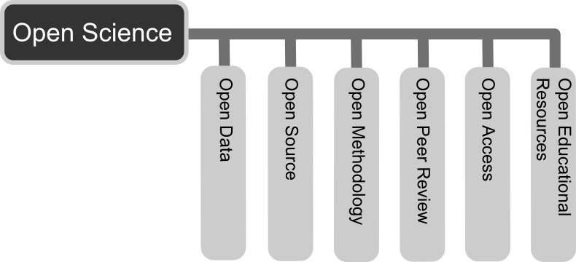
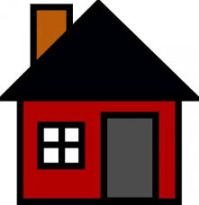
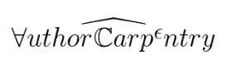
Being open and responsible at home
How to be a responsible and open data scientist
Doing responsible and open data science research
Tools for responsible and open data science
Create
Document
Use
Share
Preserve
Store

Slide 11
Challenges of Being
Open at Home

Slide 12

Implementing Open and Responsible Practices in Your Own Research
Challenges are common – everyone has them
Physical, social and regulatory contexts influence perceptions of Open Science and ability to engage in Open Science activities
SA1/3: I think it leads to better science
KY1/1: I won’t release data unless I first of all publish

Slide 13
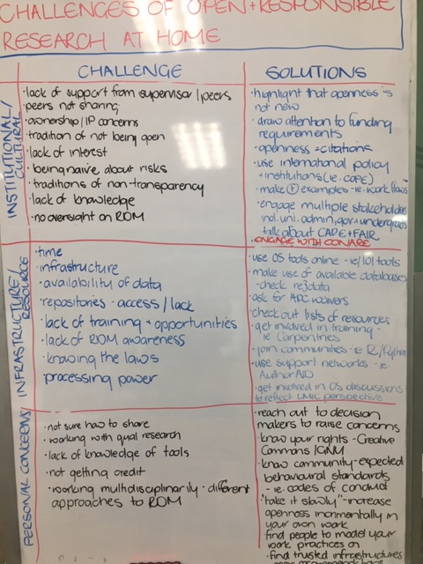
Experiencing Challenges is Normal
What specific challenges do you anticipate encountering when you return home in terms of your data work?
Think about specific, or general challenges. Take 10 minutes to write some ideas down in the googledoc.
https://tinyurl.com/8fk8af5m

Slide 14

It’s OK To Have Challenges
Challenges can be categorized into a number of different areas:
Cultural resistance and lack of institutional/peer support
Resource limitations
Personal concerns
Challenges are not insurmountable – many resources can help address them

Slide 15
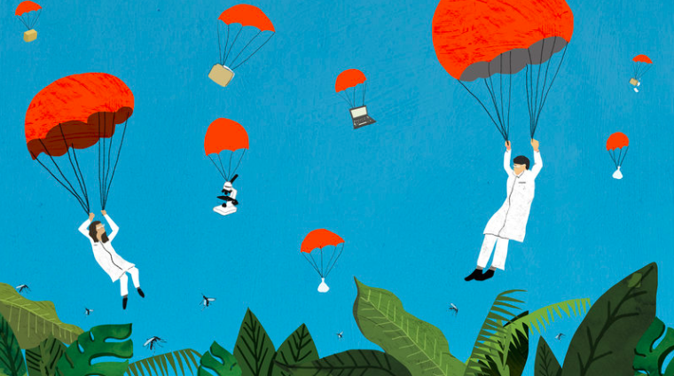
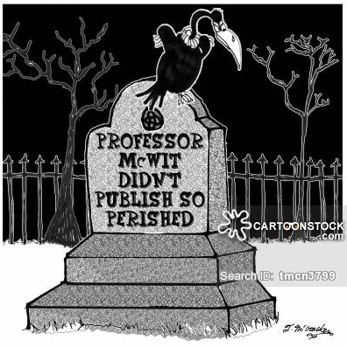
1. Cultural Resistance and Lack of Support
A quick background:
Inherited colonial academic systems
Historic lack of funding and resources limiting research scope
“Parachute research”
Problems include
Lack of institutional support
Lack of regulations/guidance
Lack of trust
Antiquated career assessment criteria

Slide 16
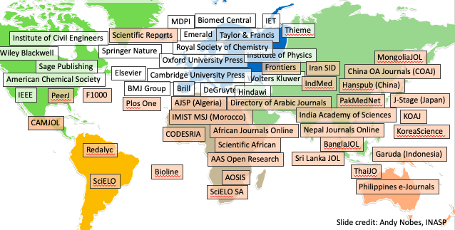
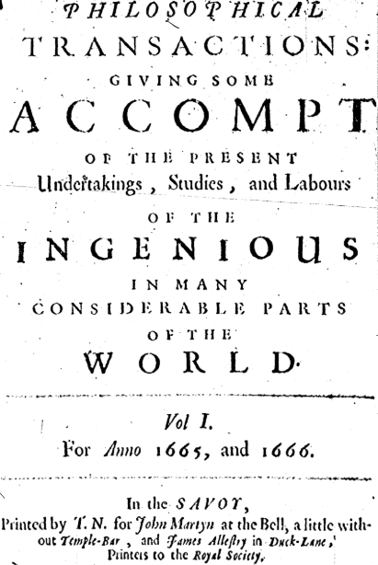
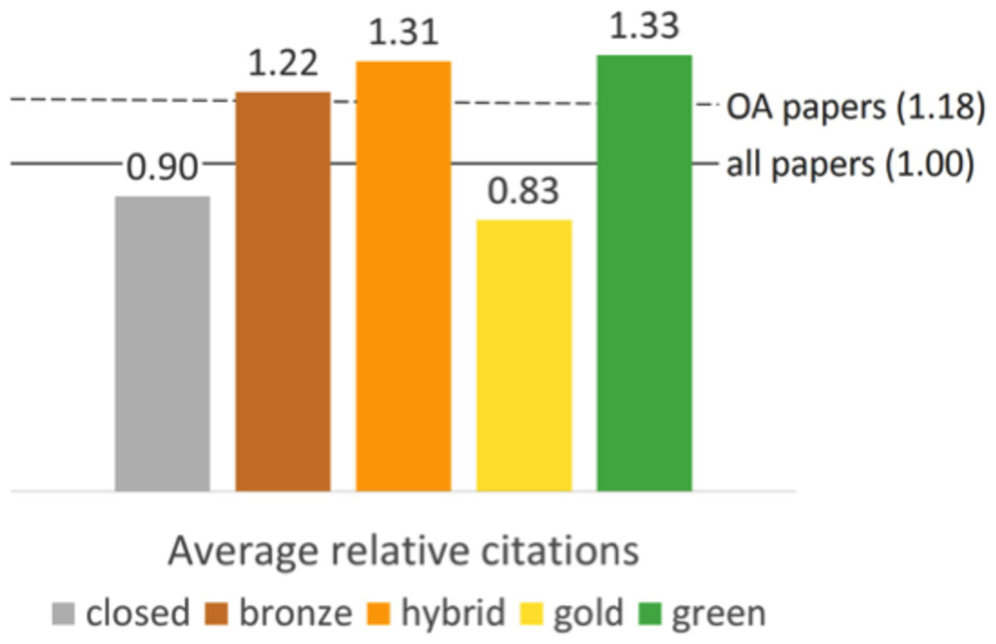
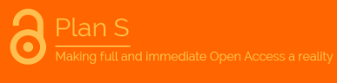
1a. Getting Your Institution On Board
Piwowar 2018
Notes:
Bronze – hybrid OA – article free to read on the publisher website, without an explicit open license

Slide 17


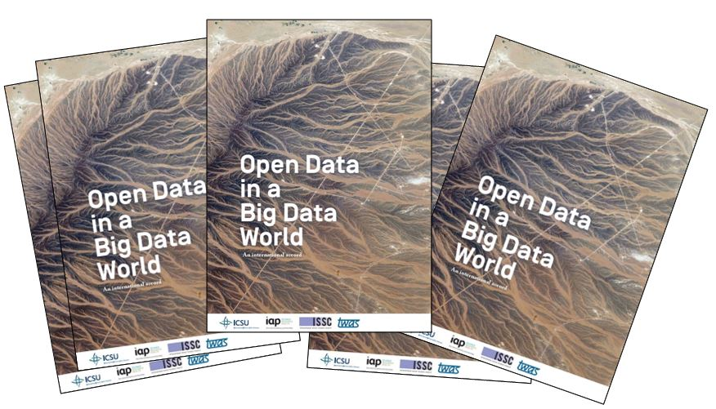




1b. Getting Better Protection and Guidance

Slide 18

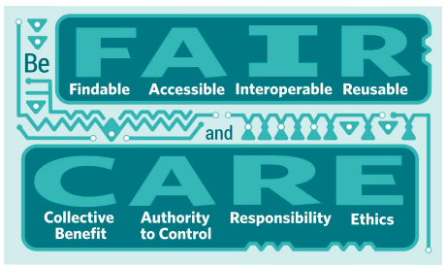
1c. Getting Over Issues of Trust
Notes:
Data moratoria
New community guidelines
International appeal boards and regulations
MOUs

Slide 19

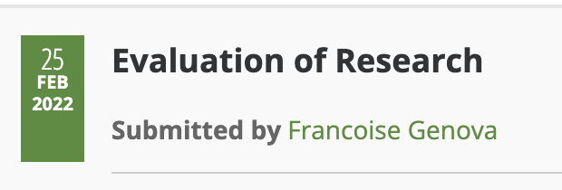


1d. Changing the Way We Assess Research Excellence

Slide 20

Still Needed: Positive Examples
Need for more positive examples to dispel “urban myths” and lurking ghosts
Need enthusiastic champions and mentors
Effective personal networks
What else can help foster
open research cultures and
maximize their support?
www.bbc.com

Slide 21
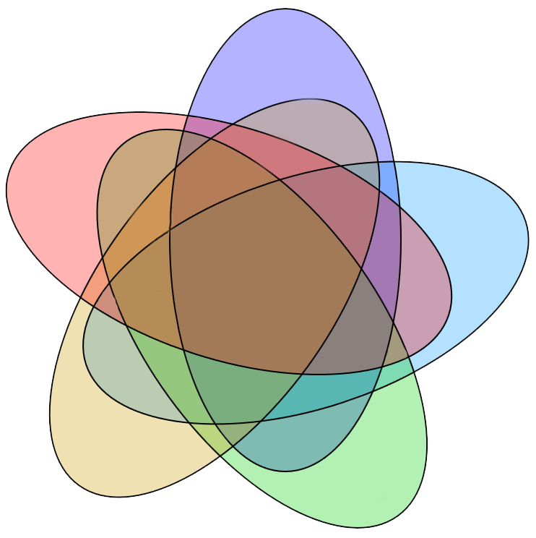
2. Infrastructures that Support Openness
Many institutions struggle with legacies of low-resourcing
Strategic resource distribution often means that OS activities are under-funded
Lack of finances to fund Open Science practices
Lack of ICT infrastructures
Lack of technical support
Lack of guidance
Physical
environment
Cultural
enviro
Work
culture
Open Science
practices
Online
environment
Bureaucratic
enviro

Slide 22
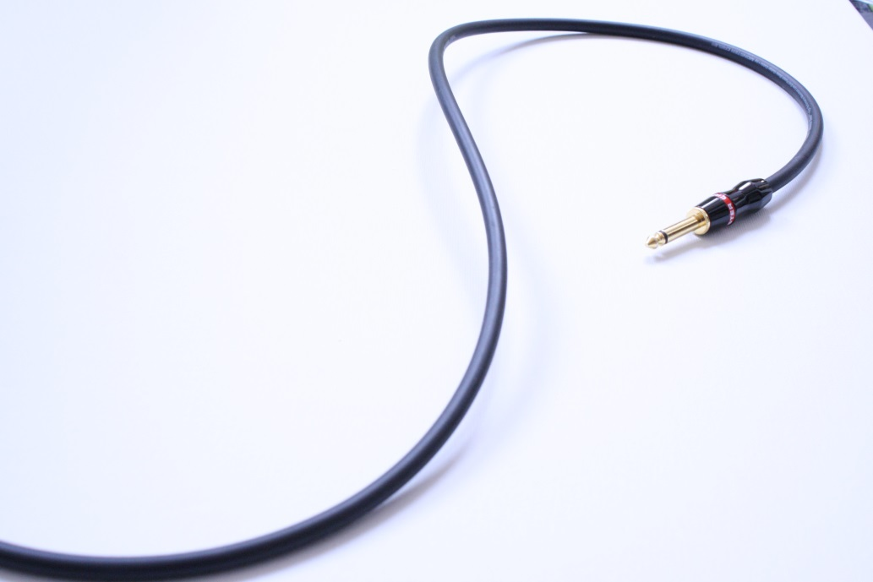
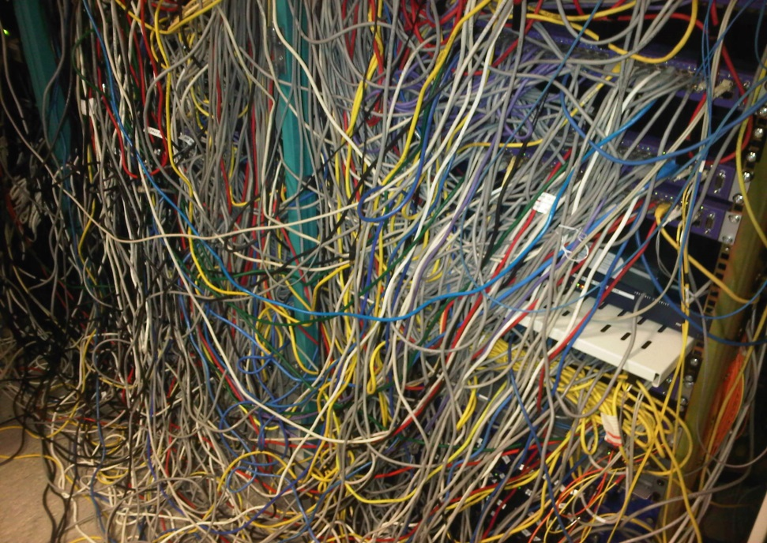
Just Because the Resources Are Online …
…. doesn’t mean they’re accessible

Slide 23
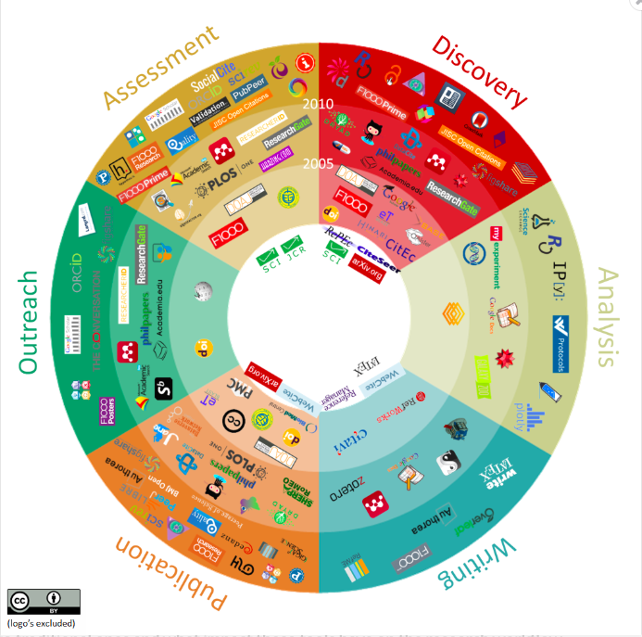
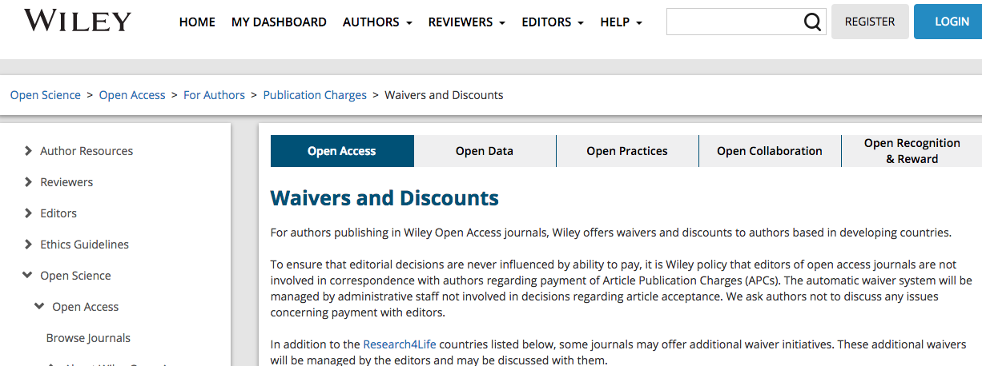
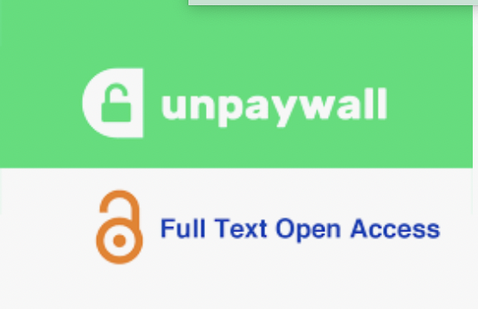
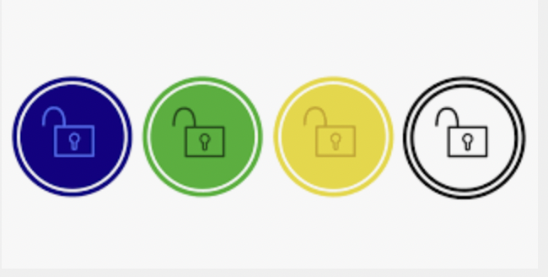

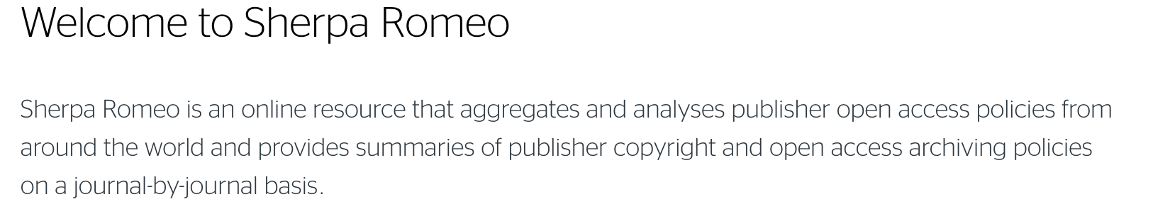
2a. Lack of Resources

Slide 24
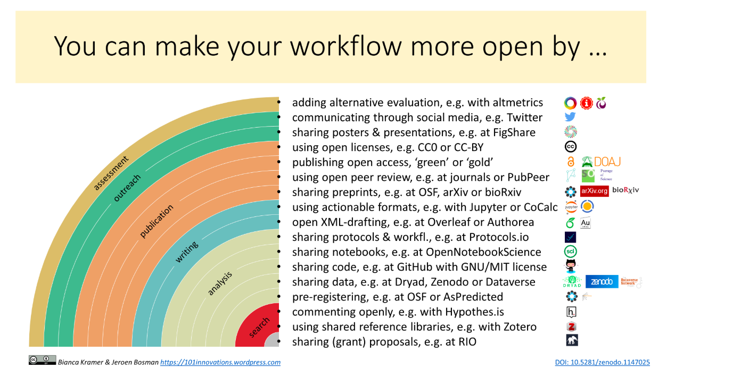
You can make your workflow more open by …

Slide 25



2a. Knowing Where to Look
Repositories can enable data sharing without institutional investment
Many Open Access databases can provide data. Ie.
Global Partnership for Sustainable Development Data www.data4sdgs.org
Listing of Open Access Databases www.loadb.org
Research4Life programme
Journal access
AGORA – access to global online research in agriculture www.fao.org/agora/en/
HINARI – access to research for health programme www.who.int/hinari/en/
OARE – online access to research in the environment www.web.unep.org/oare/
ARDI – access to research for development and innovation www.wipo.int/ardi/en/
NB. Logging in necessary via institutional ID and can require institutional network/VPN

Slide 26




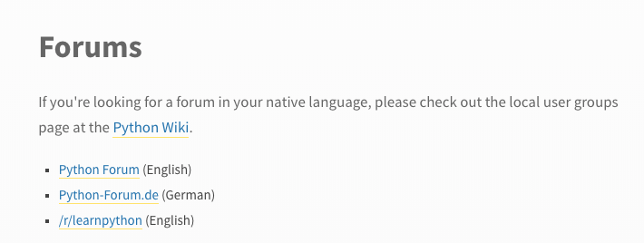

2b. Lack of Expertise and Training

Slide 27
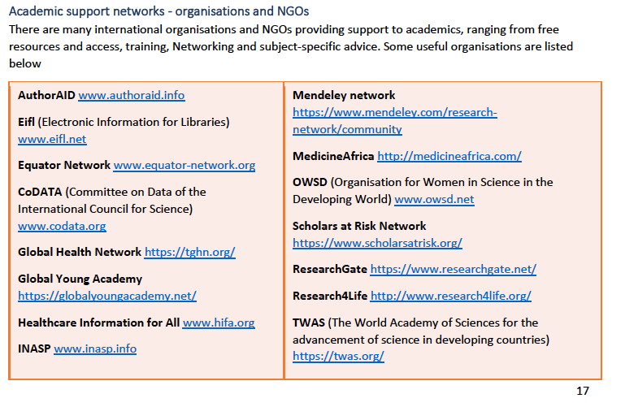
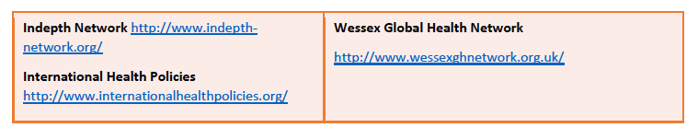
Support Networks
Thanks to Andy Nobes, INASP

Slide 28

Still Needed
Local investment in Open Science infrastructures may take time
However, global infrastructures and practices are changing rapidly
Need more LMIC voices in these discussions to make sure that they work for researchers in lower-resourced contexts
What else can help researchers overcome resource limitations?

Slide 29
3. Personal Concerns
As researchers we have concerns about implementing some Open Science practices
These concerns are legitimate, and often relate to cultural and regulatory challenges
Concerns about being scooped
Concerns about scrutiny of data and methods
Misuse of data
Unintended harms

Slide 30



3a. Knowing Your Rights/Responsibilities

Slide 31
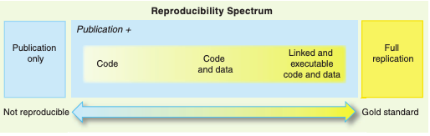
3b. Openness as a Continuum
”Your primary collaborator is yourself 6 months from now, and your past self doesn’t answer emails" (Russ Poldrack)
Peng 2011

Slide 32

3c. Managing Risk
Unintended harms are an unavoidable element of research
Using trusted infrastructures can offset some concern as they set requirements on users and contributors
Discuss concerns with peers – often they will have good advice

Slide 33

Still Needed: More Evidence
Lack of evidence of LMIC concerns
Tendency to treat LMICs concerns as “same as HIC but more”
Need more evidence about what is working, what is preferred and what is still needed
Creating, joining and interlinking networks of support is key to fostering Open Science
What else can help researchers overcome concerns about being open?

Slide 34
Openness Is A Lifelong Journey
Publish Preprints
FAIRify data
Make code available
Publish Lab-Notebooks
Use version control
Preregister your project
Do science communication

Slide 35
Let’s go back to our notes and see what resources we can fill in

Slide 36
Learning to Look at
the Bigger Picture

Slide 37
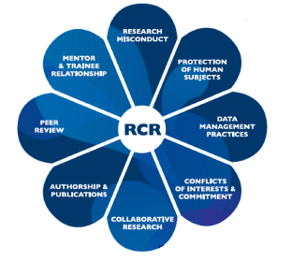
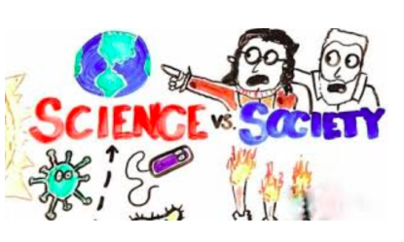

Looking at the Bigger Picture: Ethical Challenges of Data Science

Slide 38
Challenges Beyond the Research Context
technology affects communication, collaboration and knowledge exchange within scientific, work and home settings
need to help people to use those innovations more productively and safely
need to improve ways in which new technologies can be designed and developed to be more responsive to societal acceptability and desirability
Not just about being open/closed. It’s about being intentionally open. How can we be sure that openness will lead to a better future?
Notes:
Some of the concrete outcomes we pursue in our work incl, improved design and resp develop – so in addition to design might be issues such as user education, policy and regulation of tech

Slide 39
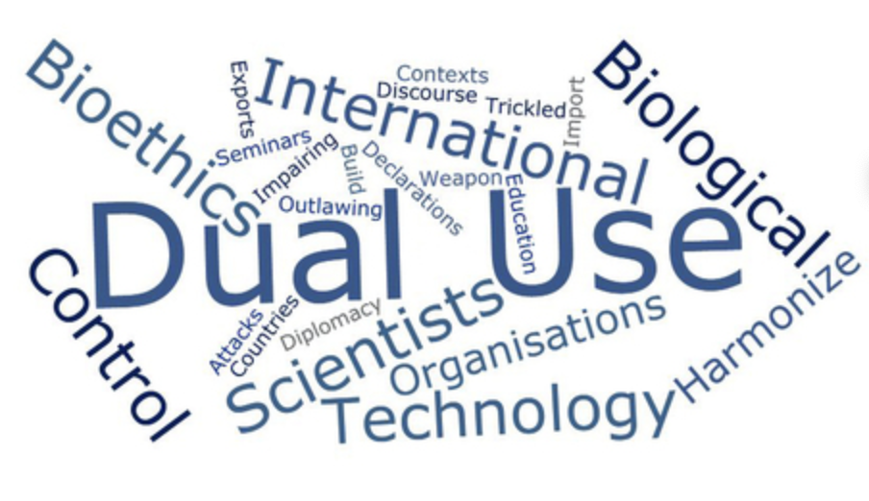
Dual-Use and Responsible Research and Innovation
RRI
Ethics
Gender equality
Governance
Open Access
Public engagement
Science education
How can we be sure the technologies that we develop are contributing to societal good and won’t cause harm?

Slide 40
Societally Responsible and Inclusive Technologies
We all have a responsibility to ensure that the technologies that are being developed are the technologies we want as a society
Any technology should:
Not increase the marginalization of certain members of society
Appropriately reflect society as a whole
Be accessible to members of the society to facilitate informed decision-making
Uphold the values and morals of society

Slide 41
RRI and Digital Technologies
Key to understanding responsible technologies is recognizing the human involvement in the development procedure
Make decisions about what data to select
Design algorithms to achieve desired computation results
Design interfaces for users
Everyone holds a world view that shapes how they understand the world
This can lead to accidental or intentional inclusions of bias into the design of technologies

Slide 42
Bias
Bias
Inclination or prejudice for or against one person or group, especially in a way considered to be unfair.
Discrimination
Unequal treatment of persons on the basis of ‘protected characteristics’ such as race, sexual identity etc.
Bias in algorithms
Unjustified and/or unintended deviation in the distribution of algorithm outputs, with respect to one or more of its parameter dimensions
Notes:
Will orient more to the second definition as that’s what debate around controversies attend to and questions given by discussion organisers

Slide 43
Causing Harm Through Bias and Discrimination
The data that you select in your analyses can produce biases
The algorithms that you design can perpetuate biases and stereotypes
The websites, platforms, sharing pathways that you design, endorse or populate can perpetuate discrimination
The data you generate can be re-used, re-combined, re-purposed in unexpected ways
This can lead to technologies that harm the societies that they are supposed to be helping

Slide 44
Value Ladened Nature of Algorithmic Design
“Algorithms are inescapably value-laden. Operational parameters are specified by developers and configured by users with desired outcomes in mind that privilege some values and interests over others…[O]peration within accepted parameters does not guarantee ethically acceptable behaviour… for example, profiling algorithms that discriminate against marginalised populations”
(Mittelstadt, Allo, Taddeo, Wachter, Floridi, 2016)
Notes:
Key points = a series of questions and challenges presented by these issues
Data or choice of what data to include as relevant – choice to include race or proxies for race etc.
Where we have humans developing the tech, there will be existence of values and with values potential for bias. Incr aware of unconscious bias so alsohave to consider this

Slide 45
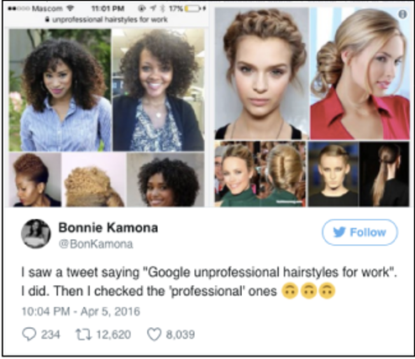
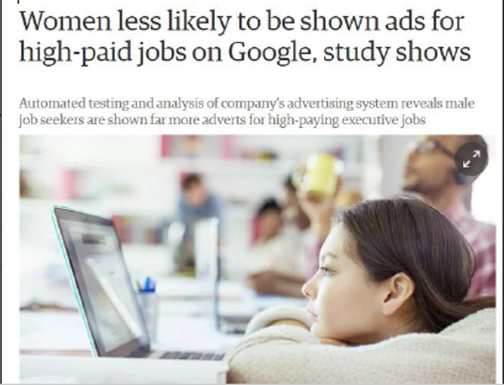
Unethical Algorithms
What are developers assuming about the world when they design digital technologies?
What real world implications are there when we ignore these assumptions?

Slide 46
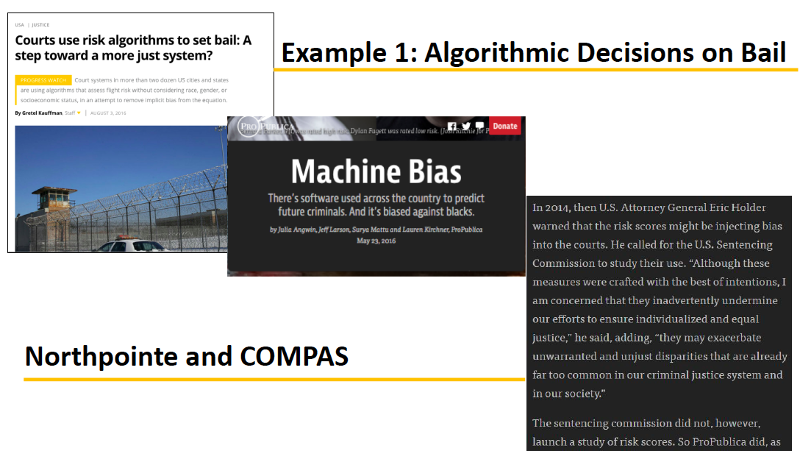
Example 1: Algorithmic decisions on bail

Slide 47
Eliminating Human Bias?
In the early 2000s the US criminal justice system began using risk assessments to assist decision-making
Software was supposed to overcome human bias of bail committees
Assessments based on algorithmic calculations to predict, for instance, how likely an individual is to re-offend or fail to attend court for sentencing.
Used to determine whether an individual should be granted bail or how long their sentence should be
‘Low risk’ offenders given shorter sentences and perhaps even kept out of jail entirely.

Slide 48
Proprietary Software to Determine Risk?
Risk assessments are now used across a wide number of states at all stages of the legal process
Software and scores provided by for-profit companies such as Northpointe
Scores derived from 137 questions, either answered by defendants or pulled from criminal records
Questions related to factors such as personal offender history, family offender history, drug taking amongst friends and personal views on offending. Race was not one of the questions.
Criteria through which the scores are generated is proprietary to Northpointe and not released – no insight into how the algorithm generates risk assessment scores

Slide 49
Looking at the Data
61%: individuals rated likely to reoffend being re-arrested (including misdemeanours such as driving with an expired license)
20%: individuals rated likely to commit a violent crime actually doing so in the future
2x: More black people were almost twice as likely to be falsely labelled as at risk of future offending than white people
<: More white people were mislabelled as low risk more often than black people;
Even when statistical tests were run to isolate the effect of race from criminal history, recidivism, age and gender, black people were:
77% more likely to be labelled as at risk of committing a future violent crime than white people
45% more likely to be labelled as at risk of committing any kind of crime
Notes:
So stated that ultimately the algorithm systematically less fair to black population – so was biased as either intended or unintended characteristic of the algorithm

Slide 50
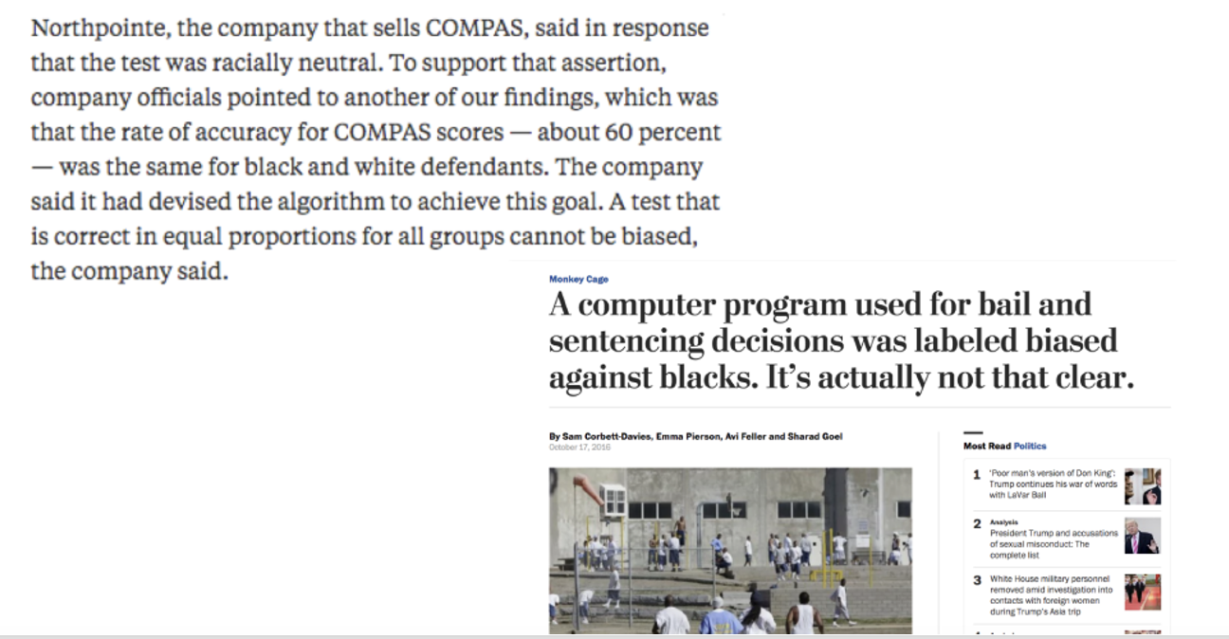
Is the Software Unethical?
Equally right at predicting reoffending vs unequally wrong at mislabelling
Unequally wrong for false positives in different populations = unfair (Pro Publica argument)
Equally right in predicting reoffending = fair (Northpointe argument)
Base populations have different levels of reoffending so algorithm cannot be equally wrong and equally right for both populations

Slide 51
Even the Smallest Decisions Can Introduce Bias
What definitions of fairness can be applied to algorithms?
Different definitions (Northpointe vs ProPublica) of fair can lead to different levels of acceptance
Bias originates with selection of data and categories used to generate scores
it would be possible for any algorithm to be both equally wrong and equally right for black and white populations.
Treatment does not take into account complex societal issues associated with these categories = biases
Notes:
In essence applying dif dimensions of fairness to suggest whether the bias might be problematic
Northpointe countered Pro Publica’s analysis and criticisms by stating that the algorithm was racially neutral because it had a 60% rate of accuracy for both white and black people.
Since then much debate has occurred over what definitions of fairness can be applied to assess algorithms of this kind. For example, some observers have pointed out that Pro Publica claims the algorithm is unfair because it is unequally wrong (i.e. more wrong for blacks than white when making false positives) whereas Norhtpointe claim it is fair because it is equally right when predicting recidivism.
These same observers also point out that it would not be possible for any algorithm to be both equally wrong and equally right for black and white populations as blacks have a higher rate of recidivism so the two base populations are therefore unequal. In that sense the bias originates in the data

Slide 52


Campaigning for Justice: ProPublica
Increasing amount of discussion about use of Northpointe COMPAS in judiciary
Proprietary algorithms determining individual futures
Inability to scrutinize processes through which decisions are made unjust
Uncritically accepting algorithmic decisions can mean that the justice system is failing in duty of care

Slide 53
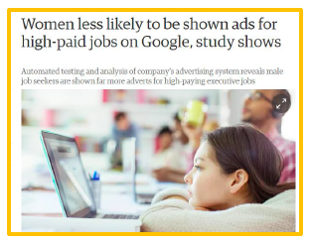
Rebalancing data
we have to think about how to rebalance the data so that that discrimination is not propagated through the algorithms. How does one come up with a fair set of data, which can actually challenge the biases that might naturally be there …
Not as easy as it sounds …

Slide 54
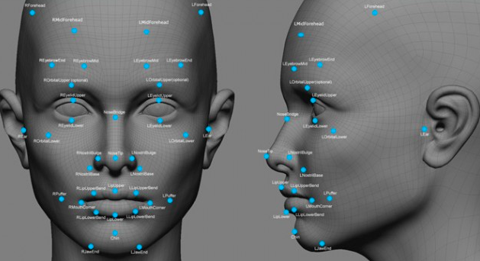
Example 2: Facial Recognition Software
Joy Buolamwini (MIT)
Software created by brand-name tech firms such as Amazon uncovered much higher error rates in classifying the gender of darker-skinned women than for lighter-skinned men.
Other problems – unable to reliably detect Asian eyes
Location of software companies and demographics = non-representative datasets used in algorithm development

Slide 55
Significant Harms From Deployment
Called on Amazon to stop selling its facial recognition software to police.
Caution about the fast-moving adoption of facial recognition by police, government agencies and businesses from stores to apartment complexes
Computer vision systems that enable self-driving cars to “see” the road shows they have a harder time detecting pedestrians with darker skin tones.

Slide 56
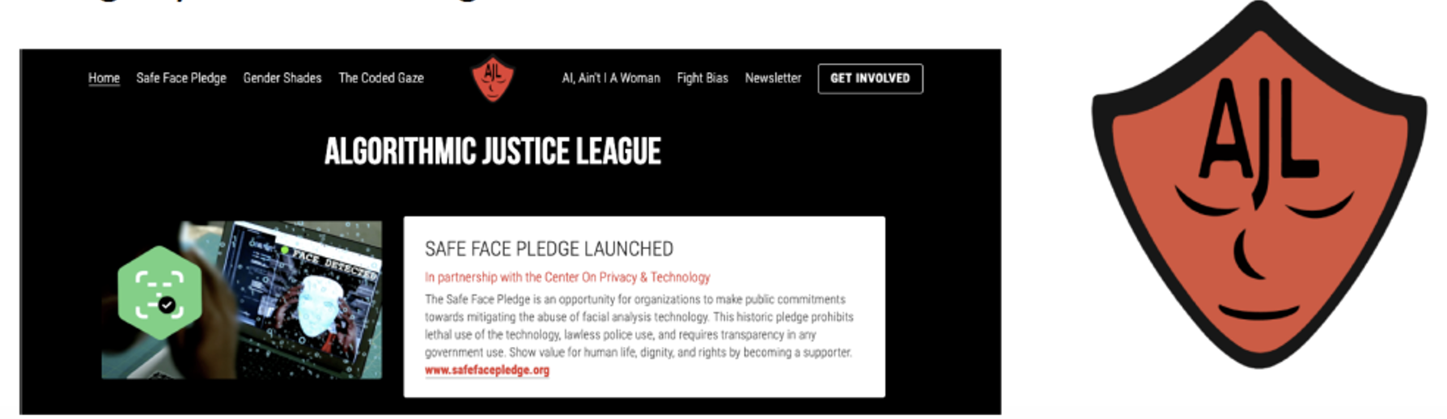
Algorithmic Justice League
Algorithmic activism
”Naming and shaming of companies”
“Safe Face Pledge” – addresses bias, facilitates transparency, promotes dignity and human rights

Slide 57
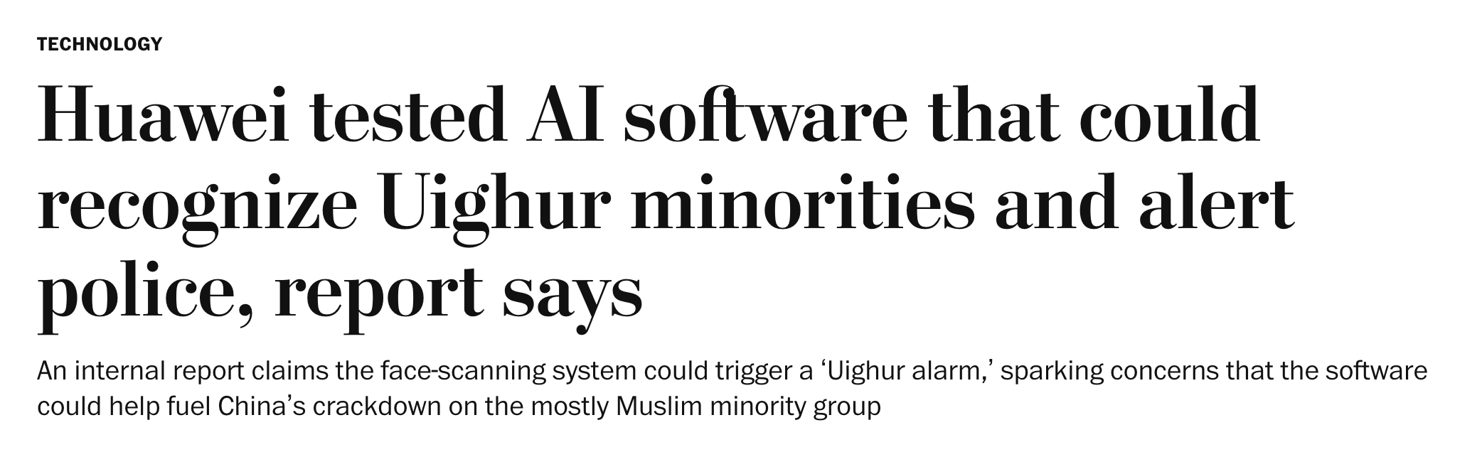
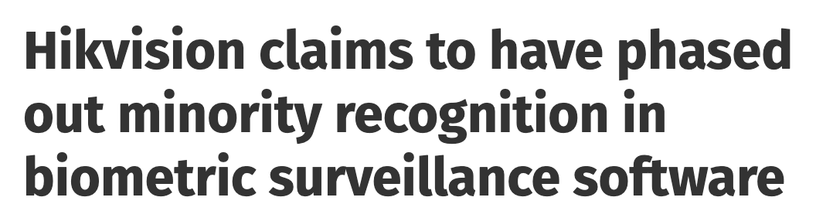
Dual/Malicious Use and Normalization
Surveillance technology commonly used in cities, workplaces and homes
Vary considerably wrt ethical compliance
Use for population control (China, Uganda etc)
Possible vulnerability for hacking via “back door” access codes
https://www.washingtonpost.com/technology/2020/12/08/huawei-tested-ai-software-that-could-recognize-uighur-minorities-alert-police-report-says/
https://www.biometricupdate.com/202007/hikvision-claims-to-have-phased-out-minority-recognition-in-biometric-surveillance-software

Slide 58
Recognizing the Politics of Data Science
Algorithms are inherently politicised [as connected to social policy and political power]… and reflect our current world views and social policy
This can lead to new biases creeping in to the world that we live in as some communities are targeted, left behind or excluded from the digital revolution
Need continual surveillance and critical reflection to make sure we are creating and deploying ethical algorithms

Slide 59
Ethical Data-Intensive RRI
Should algorithms in a sense follow a higher moral values that we think are more important than giving an exact reflection of the world?
Ie. Gender, LGBTQ+, previously disadvantaged communities
What is a representative sample of the population you are trying to model?
Should you use the data as it is?
Should you change the data, or not change but adapt the way we look at the data to serve our purpose of being non-discriminatory?
Should we purposively select for equal representation in certain marginalized categories?

Slide 60
Design Decisions Can Cause Real-World Harms
Unlikely that Northpointe or Amazon developers were trying to maliciously introduce bias
Designing to the best of their ability within their worldview using data that was readily available
Small decisions and lack of critical reflection led to large real-world harms
Even the smallest decision, developer or task can have significant impact

Slide 61
Ethics at the Centre of Data Science
Research practices and the tools that underpin them have ethical implications
Even the smallest tools, practices and decisions can have significant ethical consequences
Get independent researchers to check your code/data selection/results to expose biases
Always critically examine the decisions you’re making in your research and ask “why do I think that way”?
Be critical of the code and results you’re using – how did they get to the point they did?
Think about how other cultures will respond to your decisions

Slide 62
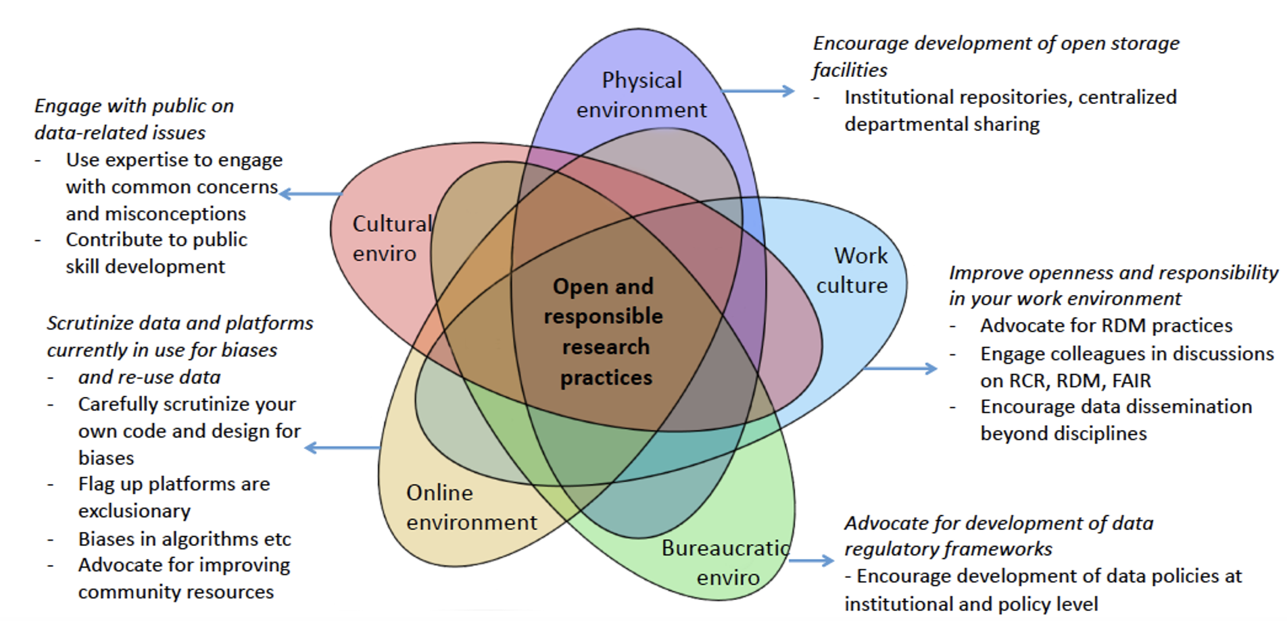
Extending Data Science Citizenship Responsibilities

Slide 63
Outline for Next Week
Over the course of next week, reflect on the tools that you are going to be taught. Think about:
How you can safeguard beneficial outcomes of your activities in data gathering, infrastructure building and data dissemination?
How can you discuss these issues with your colleagues and peers?
How can you scrutinize the systems/datasets you will work with to make sure that biases do not creep into your research systems?
How can responsible and open science citizen strengthen these activities?

Slide 64
Thank You
Please feel free to contact me with any further questions!
l.m.bezuidenhout@cwts.leidenuniv.nl

